Slide 1
ChatGPT: Training an LLM
Sam Scott, Mohawk College, June 2023

Slide 2
Reminder: The Task
Given a text prompt, predict the natural language token (word) that comes next.
ChatGPT is a Large Language Model powered by a deep Artificial Neural Network architecture called a Transformer.

Slide 3
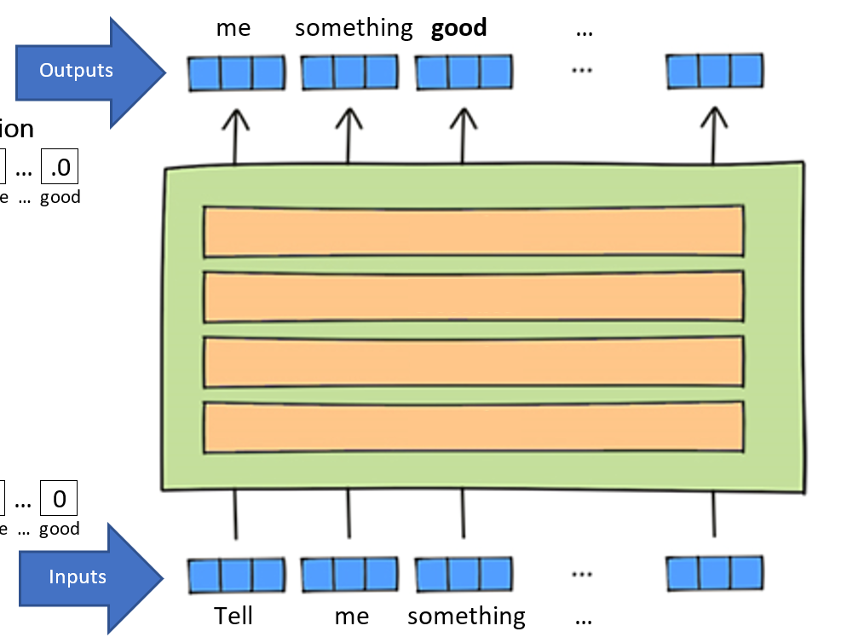
Reminder: The Journey
ChatGPT generates one word at a time based on a generalized context.
Numbers to Words
Attention to Context
Encode Position
Words to Numbers
Adapted from https://www.lavivienpost.com/how-chatgpt-works-architecture-illustrated/

Slide 4

Training Methods for ChatGPT
Reward
Modelling
Supervised
Fine Tuning
Base Model
Training
RLHF
Reinforcement
Learning
ChatGPT

Slide 5
Base Model Training
Typical Scope | Human Involvement | Base Models
A trillion tokens, 1000 GPUs, many months | None | davinci, curie, babbage, ada
The Study Archive file format is a data compression and archive format, based directly on the ZIP file format.[1] Study archives are intended for the development and use of sets of interactive flashcards, which may contain not only text but also images and audio files, in various applications.
The Study Archive file format is a data compression and archive format, based directly on the ZIP file format.[1] Study archives are intended for the development and use of sets of interactive flashcards, which may contain not only text but also images and audio files, in various applications.
The Study Archive file format is a data compression and archive format, based directly on the ZIP file format.[1] Study archives are intended for the development and use of sets of interactive flashcards, which may contain not only text but also images and audio files, in various applications.
The Study Archive file format is a data compression and archive format, based directly on the ZIP file format.[1] Study archives are intended for the development and use of sets of interactive flashcards, which may contain not only text but also images and audio files, in various applications.
used
Input
WRONG!
Target output
System is gently nudged in the right direction.

Slide 6
Supervised Fine Tuning
Typical Scope | Human Involvement | SFT Models
100 000 prompts and responses, 100 GPUs, one month | Prompts with responses | davinci-instruct-beta
Prompt: Can you give me some suggestions for classic 90's rock songs I would like? I'm a big fan of Nirvana and Pearl Jam but I know all their songs already.
Response: 1. Soundgarden – Rusty Cage, 2. Radiohead – Creep, 3. Smashing Pumpkins – 1979
Prompt: Hi, how are you today?
Response: As an AI, I do not have feelings or emotions, but I am here to help you. How can I assist you today?

Slide 7
Supervised Fine Tuning
Typical Scope | Human Involvement | SFT Models
100 000 prompts and responses, 100 GPUs, one month | Prompts with responses | davinci-instruct-beta
Prompt: Can you give me some suggestions for classic 90's rock songs I would like? I'm a big fan of Nirvana and Pearl Jam but I know all their songs already.
Response: 1. Soundgarden – Rusty Cage, 2. Radiohead – Creep, 3. Smashing Pumpkins – 1979

Slide 8
Supervised Fine Tuning
Typical Scope | Human Involvement | SFT Models
100 000 prompts and responses, 100 GPUs, one month | Prompts with responses | davinci-instruct-beta
Prompt: Can you give me some suggestions for classic 90's rock songs I would like? I'm a big fan of Nirvana and Pearl Jam but I know all their songs already.
Response: 1. Soundgarden – Rusty Cage, 2. Radiohead – Creep, 3. Smashing Pumpkins – 1979
Nirvana
Input
WRONG!
Target output
System is gently nudged in the right direction.

Slide 9
Reward Modelling
Typical Scope | Human Involvement | Reward Models
A million response ratings, 100 GPUs, one month | Response ratings | N.A.
Prompt: Can you give me some suggestions for classic 90's rock songs I would like? I'm a big fan of Nirvana and Pearl Jam but I know all their songs already.
Response: 1. Nirvana – Drain You, 2. Pearl Jam – Jeremy, 3. Smashing Pumpkins – 1979 <|end|> <|-0.2|>
Prompt: Hi, how are you today?
Response: As an AI, I do not have feelings or emotions, but I am here to help you. How can I assist you today? <|end|> <|1.0|>
End
Reward
End
Reward

Slide 10
Reward Modelling
Typical Scope | Human Involvement | Reward Models
A million response ratings, 100 GPUs, one month | Response ratings | N.A.
Prompt: Can you give me some suggestions for classic 90's rock songs I would like? I'm a big fan of Nirvana and Pearl Jam but I know all their songs already.
Response: 1. Nirvana – Drain You, 2. Pearl Jam – Jeremy, 3. Smashing Pumpkins – 1979 <|end|> <|-0.2|>
Prompt: Hi, how are you today?
Response: As an AI, I do not have feelings or emotions, but I am here to help you. How can I assist you today? <|end|> <|1.0|>
Input
Target output

Slide 11
Reward Modelling
Typical Scope | Human Involvement | Reward Models
A million response ratings, 100 GPUs, one month | Response ratings | N.A.
Prompt: Can you give me some suggestions for classic 90's rock songs I would like? I'm a big fan of Nirvana and Pearl Jam but I know all their songs already.
Response: 1. Nirvana – Drain You, 2. Pearl Jam – Jeremy, 3. Smashing Pumpkins – 1979 <|end|> <|-0.2|>
Prompt: Hi, how are you today?
Response: As an AI, I do not have feelings or emotions, but I am here to help you. How can I assist you today? <|end|> <|1.0|>
Input
Target output

Slide 12
Reinforcement Learning
Typical Scope | Human Involvement | RLHF Models
30 000 prompts, 100 GPUs, one month | Prompts | text-davinci-003, ChatGPT
Prompt: Can you give me some suggestions for classic 90's rock songs I would like? I'm a big fan of Nirvana and Pearl Jam but I know all their songs already.
Response: 1. Nirvana – Drain You, 2. Pearl Jam – Jeremy, 3. Smashing Pumpkins – 1979 <|end|>
Reward Model: -0.4
System is nudged away from producing these tokens.

Slide 13
Reinforcement Learning
Typical Scope | Human Involvement | RLHF Models
30 000 prompts, 100 GPUs, one month | Prompts | text-davinci-003, ChatGPT, etc.
Prompt: Hi, how are you today?
Response: As an AI, I do not have feelings or emotions, but I am here to help you. How can I assist you today? <|end|>
Reward Model: 1.3
System is nudged towards producing these tokens.

Slide 14
Training Methods Recap
Type | Scope | Humans

Slide 15
Training Methods Recap
Type | Scope | Humans
Base Model Training | 1 000 000 000 000 tokens, 1000 GPUs, months of training | None

Slide 16
Training Methods Recap
Type | Scope | Humans
Base Model Training | 1 000 000 000 000 tokens, 1000 GPUs, months of training | None
Supervised Fine Tuning | 100 000 prompts and responses, 100 GPUs, weeks of training | Prompt and response generation

Slide 17
Training Methods Recap
Type |  | Scope | Humans
Base Model Training |  | 1 000 000 000 000 tokens, 1000 GPUs, months of training | None
Supervised Fine Tuning |  | 100 000 prompts and responses, 100 GPUs, weeks of training | Prompt and response generation
R L H F | Reward Modelling | 1 000 000 response ratings, 100 GPUs, weeks of training | Response ratings
 |  |  | Prompt generation

Slide 18
Training Methods Recap
Type |  | Scope | Humans
Base Model Training |  | 1 000 000 000 000 tokens, 1000 GPUs, months of training | None
Supervised Fine Tuning |  | 100 000 prompts and responses, 100 GPUs, weeks of training | Prompt and response generation
R L H F | Reward Modelling | 1 000 000 response ratings, 100 GPUs, weeks of training | Response ratings
 | Reinforcement Learning | 30 000 prompts, 100 GPUs, weeks of training | Prompt generation

Slide 19
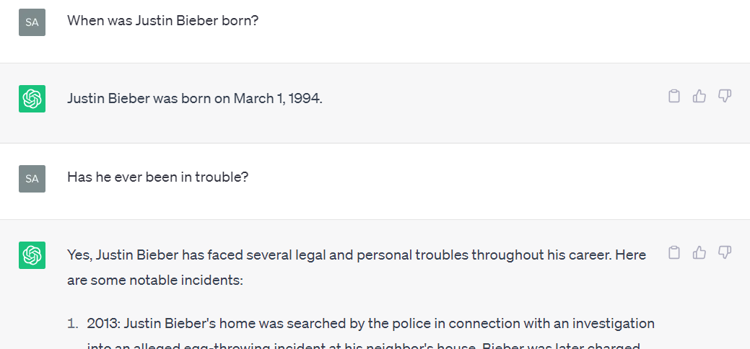
From Completion to Chat
Who is “he”?
ChatGPT seems to track the conversation
Prompt Engineering
It remembered!
ChatGPT acts like a helpful assistant.
SFT and RLHF
Prompt constraints
A “system” message

Slide 20
Can we trust ChatGPT?
Is it moderated by humans?
No
Does it memorize true information or have some kind of database?
No
Is it ok to cite ChatGPT as a source?
No!!!
There’s no author
There’s no built-in drive to tell the truth
The “hallucination” problem is not going to go away

Slide 21
Up Next…
→The Discovery of Prompt Engineering
→Social, Ethical, Cognitive Implications

